Slide 1
STD.12 CH-3 Electrochemistry(3)
Standard electrode potential

Slide 2
EMF series electro motive force
THE.. potential of a cell is measured with reference to standard hydrogen electrode.
the potential of second electrode is known as electromotive force i in brief as EMF.
If thE value of thE reduction potential of extended electrode of the half cell is arranged in the decreasing order then the series of the electrode formed is called EMF series.

Slide 3
Importance of electrode potential
The standard electrode potential are very important and we can extract a lot of useful information from them. The value of Standard potential for selected half cell ,reduction reaction given in the table.

Slide 4
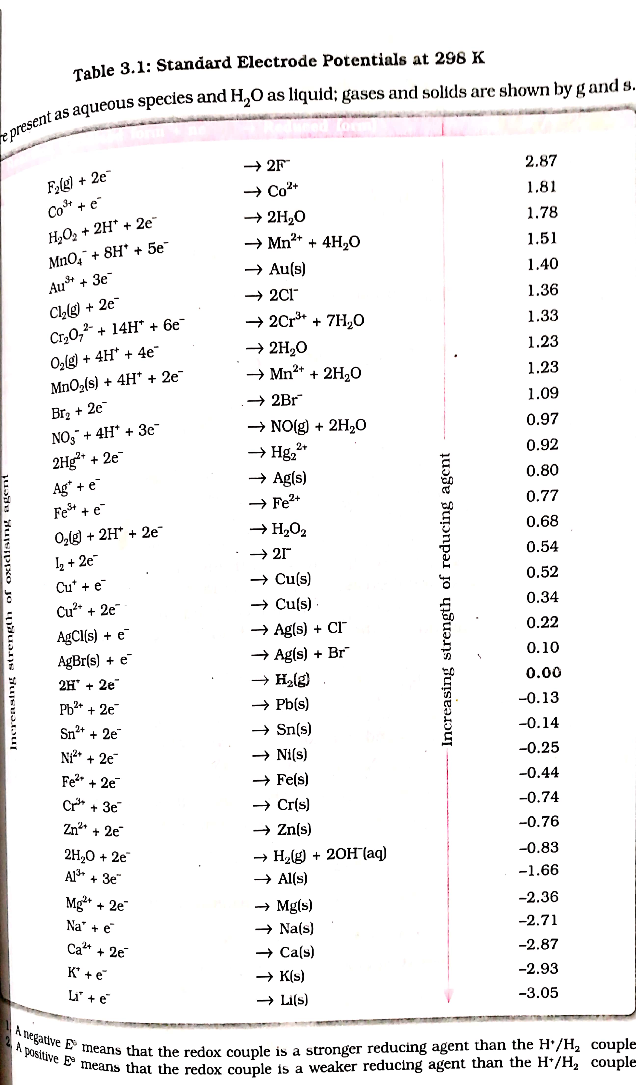

Slide 5
If the standard electrode potential of an electrode is greater than zero then its reduced form is more stable compared to the hydrogen gas.

Slide 6
Similarly if the standard electrode potential is negative then hydrogen gas is more stable than the reduced form of the species.
You can see in the table that flUOrine gas F2 has the maximum tendency to get reduced to Fluoride ion F – and therefore A gas is the strongest oxidizing agent and is the weakest reducing agent. DUE TO THIS The position of standard electrode potential of fluorine in the table ON THE TOP.

Slide 7
Lithium has the lowest electrode potential indicating that Lithium ion is the weakest oxidizing agent and Lithium metal is the most powerful reducing agent in an aquous solution. That is why Lithium present in the bottom of the table
.

Slide 8
As we go from top to bottom in the table the standard electrode potential decreases. Decrease the oxidising power of the species on the left and increasing the reducing power of the species on the right-hand side of the reaction.
Electrochemical cell are extensively used for determining the pH of the solution, solubility product equilibrium constant and other thermodynamics property and for potentiometric titration.

Slide 9
A negative VALUE OF EMF, means that the redox couple is a stronger reducing agent than the H + / H2 couple.
A positive EMF means that couple is a weaker reducing agent than the
H+/ H2 couple.

Slide 10
The following information can be obtained from the series
the tendency to experience oxidation, and the strength as reducing agent increases as we go from above the below .
in the series the tendency to experience reduction reaction, tendency to accept electron and strength as oxidizing agents increases as we go from below to above, the Standard potential of the complete cell formed by combination of two half cells and calculating their Standard potential .
The information about which electrode will be anode and which will be cathode can also be obtained .
if the rod of the metal in the series which have lower position are placed in the solution of salt of metals having higher position in the series the ion will be replaced by a metal rod ,
eg. the position of Ag is below than the position of CU in the EMF series, if Ag rod is placed in solution of cu2 + the road of Ag will turn Ag/Ag + and CU 2 + / CU solid.

Slide 11
THANK YOU

